Slide 1
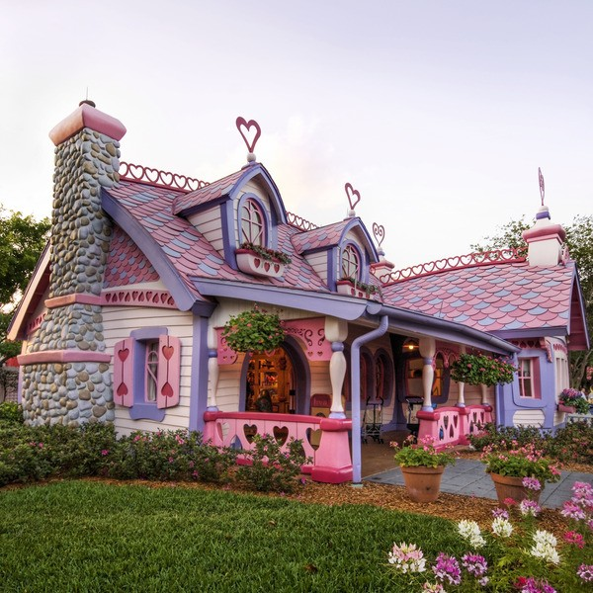
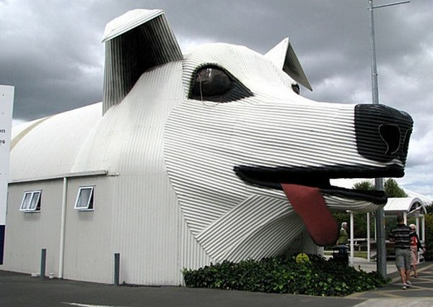
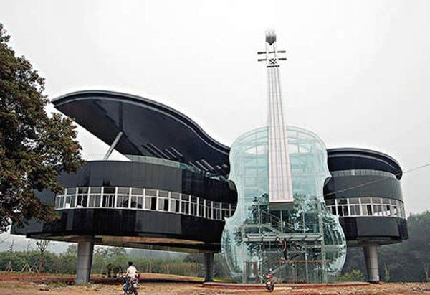
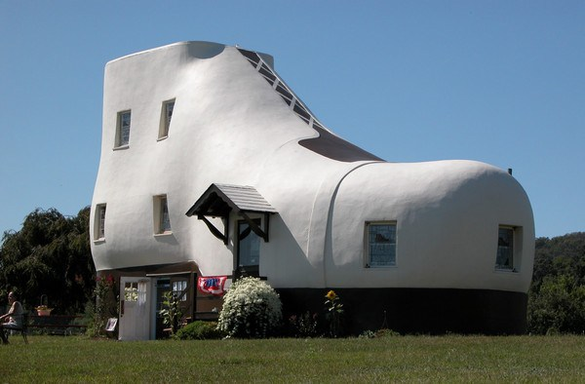
Notes:
1., Gingerbread House in Orlando: http://buzz-io.tumblr.com/post/75623125595/30-coolest-house-in-the-world - utolsó letöltés: 2016.
2., The Shoe House in Pennsylvania
3., Sheep Dog House in New Zealand
4., The Piano House in China

